Slide 1
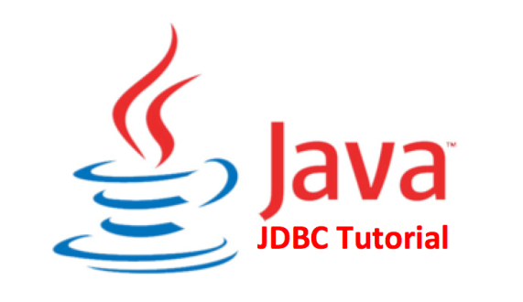
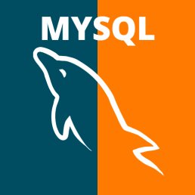
JDBC Quick Start for Your Programming Project
Victor Chen
For CS4721ers

Slide 2
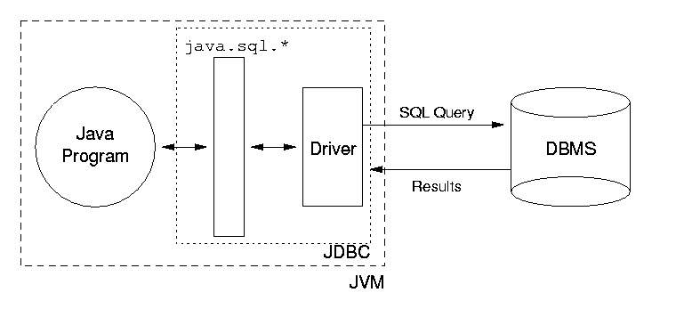
What is JDBC
JDBC : Drivers to allow Java programs to access database

Slide 3
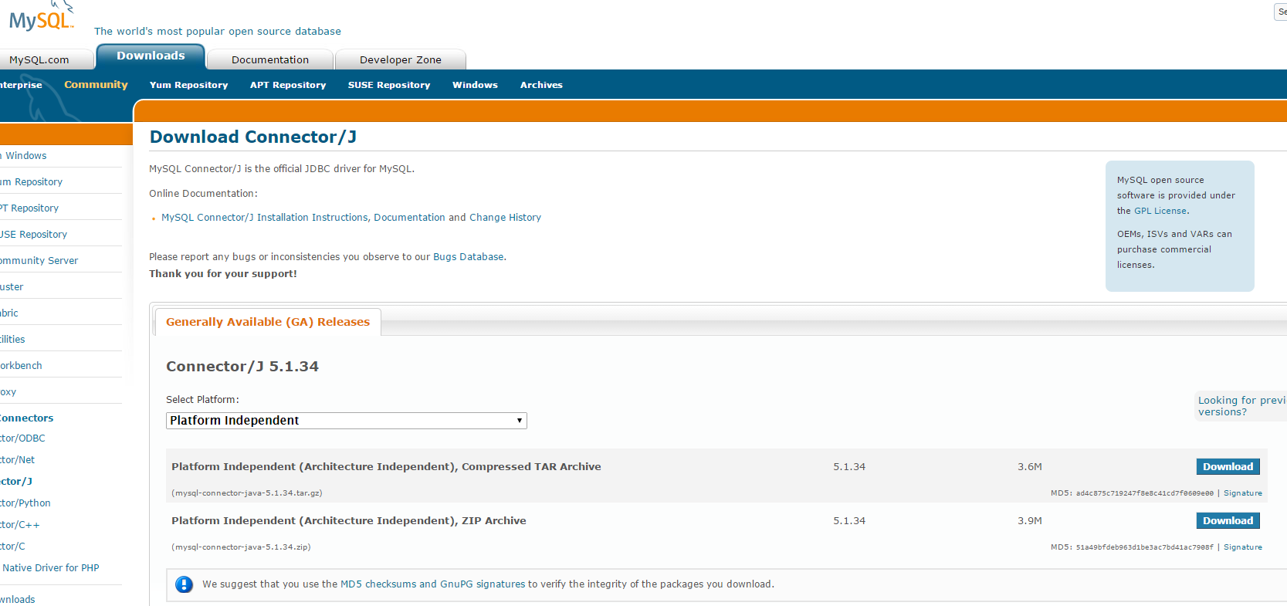
Load JDBC
Download JDBC (JAR file) for MySQL website
Add the JDBC (JAR file) to the library of your project in IDE

Slide 4
First, you need to create a connection
How to create a connection in Java?
a. Loading the Drivers:
Class.forName("com.mysql.jdbc.Driver");
b. Connect with database:
Connection con = DriverManager.getConnection(
"jdbc:mysql://localhost:3306/example","root", "root");

Slide 5
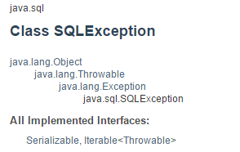
Exception Handling
Most of DB-related Java methods might throw out an instance of SQLException, which is a checked exception.

Slide 6
Next… to create statement
How to define the statements in java JDBC?
Statements Objects:-Use for access to your database.

Slide 7
Creating Statement Object:
You need to create Statement object using the Connection object's createStatement( ) method, as in the following example:
Statement stmt = null;
try {
stmt = conn.createStatement( );
. . .
}
catch (SQLException e) {
. . .
}
finally {
. . .
}

Slide 8
Run a SQL statement
Once you've created a Statement object, you can then execute a SQL statement with one of its three execute methods.
boolean execute(String SQL) : Returns true if a ResultSet object can be retrieved; otherwise, it returns false. This method works for any SQL DDL or DML statements
int executeUpdate(String SQL) : Returns the numbers of rows affected by the execution of the SQL statement. Use this method to execute an INSERT, UPDATE, DELETE statement or any DDL statements
ResultSet executeQuery(String SQL) : Returns a ResultSet object. Use this method to execute a SELECT statement.
Doc: https://docs.oracle.com/javase/8/docs/api/java/sql/Statement.html

Slide 9
Closing Statement Object and Closing a Connection object
Closing Statement Object and Closing a Connection object to save database resources.
A simple call to the close() method will do the job.
Statement stmt = null;
try {
stmt = conn.createStatement( );
. . .
}
catch (SQLException e) {
System.out.println(e.getMessage());
}
finally {
stmt.close();
}

Slide 10
Retrieving all rows from ResultSet objects
A ResultSet object is a table of data including several rows
The method ResultSet.next() moves the cursor from the current row to the next row. This method returns false if the cursor reaches the end of the result set.
Repeatedly calls the ResultSet.next() method with a while loop to make cursor iterate over all rows
Example:
ResultSet rs=stmt.executeQuery("SELECT * FROM animals");
while (rs.next()) {
…// code to parse each row
}

Slide 11
How to retrieve column values from a row?
A few getter methods are defined for ResultSet (e.g., getInt and getString) to retrieve column values from the current row where the cursor is.
You can retrieve values using either (1) the index number of the column or (2) the name of the column. Index number starts from 1
Example: int id = rs.getInt("id");
equivalent to int id = rs.getInt(1);
Doc: https://docs.oracle.com/javase/8/docs/api/java/sql/ResultSet.html

Slide 12
Put everything together
import java.sql.*
public static void main(String[] args) throws ClassNotFoundException, SQLException {
Class.forName("com.mysql.jdbc.Driver");
Connection con = DriverManager.getConnection("jdbc:mysql://localhost:3306/example","root", "root");
Statement stmt=con.createStatement();
//String str="Create table animals (id int not null, name varchar(20) not null)";
//stmt.executeUpdate("insert into animals values(26, ‘monkey')");
ResultSet rs=stmt.executeQuery("SELECT * FROM animals");
while (rs.next()) {
int id = rs.getInt("id");
String name = rs.getString("name");
System.out.print(id);
System.out.println(“\t"+name);
}
stmt.close();
con.close();
}

Slide 13
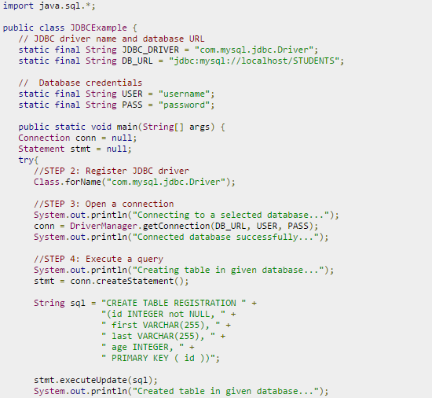
Creating tables in DB

Slide 14
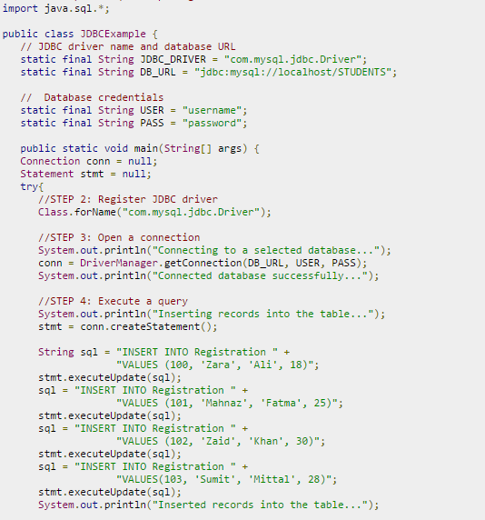
Inserting data into tables

Slide 15
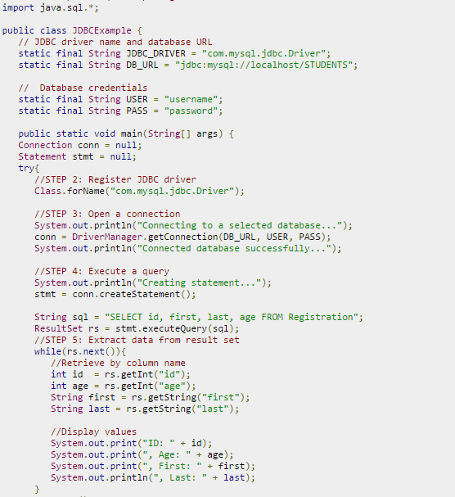
Retrieving data from DB

Slide 16
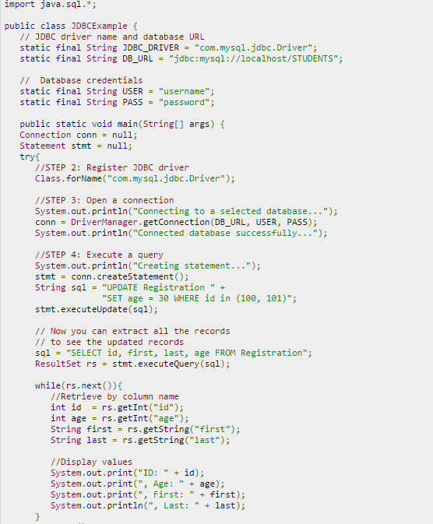
Updating data in DB

Slide 17
Tips
When you define SQL statements as Strings in Java, pay attention to quotation marks
SQL: only single quotation marks are used
Java: Enclose a string using double quotation marks
Video tutorial about using JDBC :
https://www.youtube.com/watch?v=BCqW5XwtJxY

